Slide 1

THE
FORE RUNNERS
Believe and everything is possible

Slide 2
THE FORERUNNERS
Basura Ratnayake
10541973
Shamika Algawatta
10541922
Prageeth Kasun
10541912
Dulan Hewage
10541920
Chamodi Rathnasinghe
10541970

Slide 3
FORE RUNNERS
BUS RIYA

Slide 4
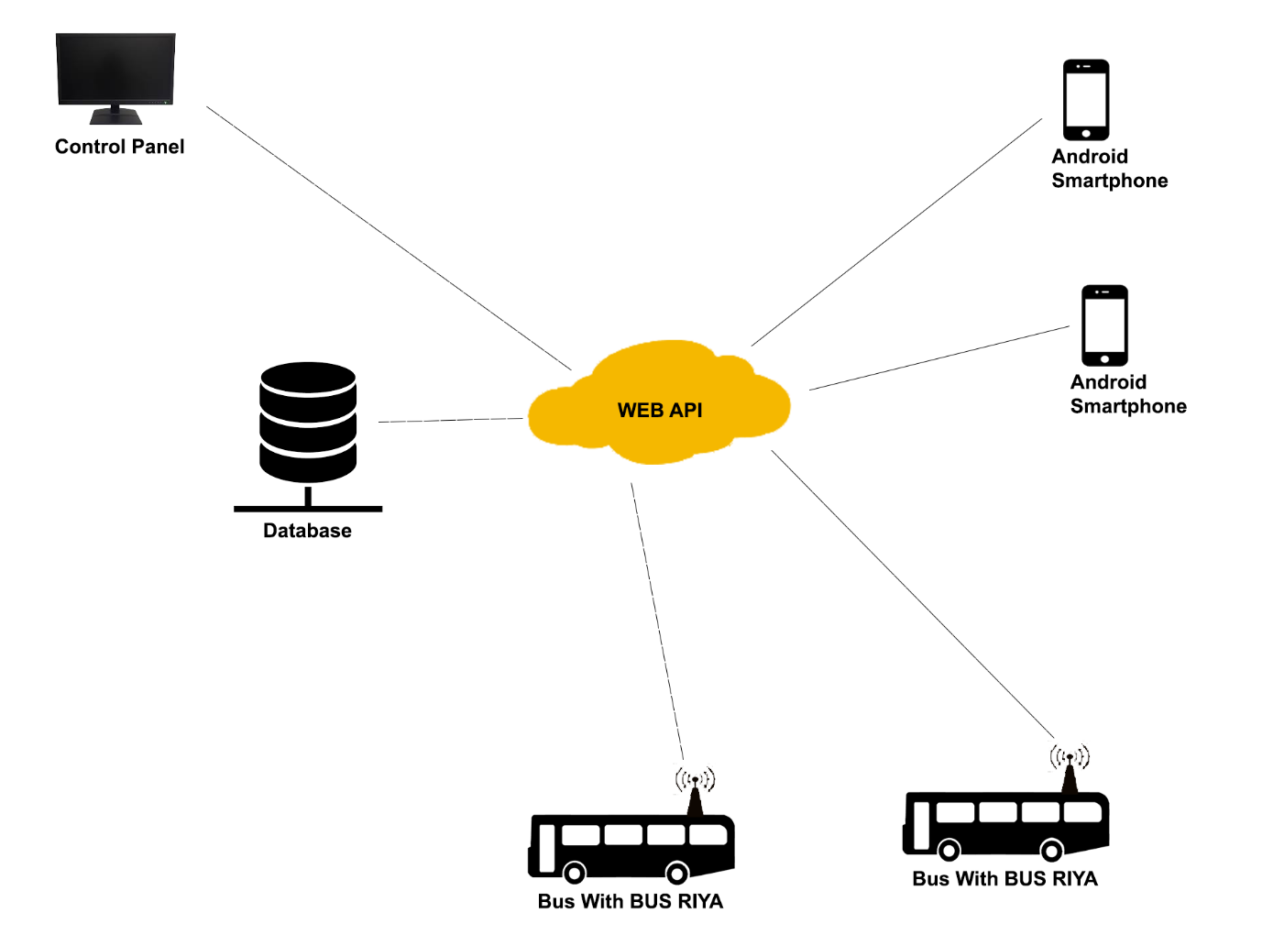
Basic Architecture

Slide 5
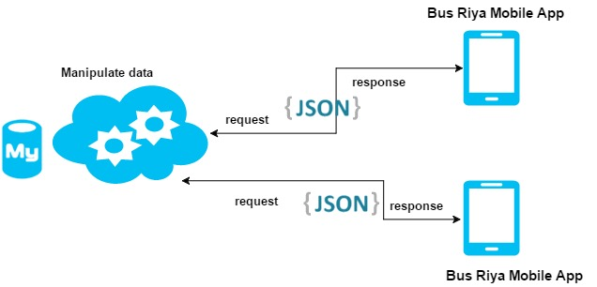
Request Structure

Slide 6
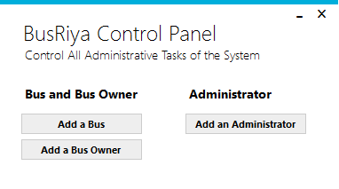
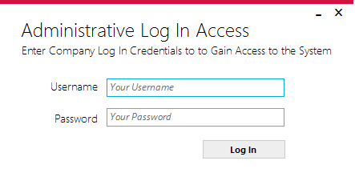
DESKTOP APPLICATION
Manages Administrative Features of the System
Handles the Bus Transactions of the Server

Slide 7
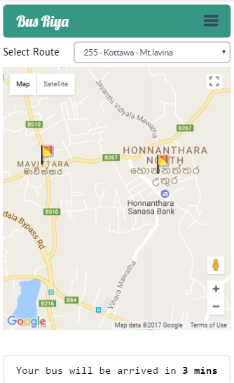
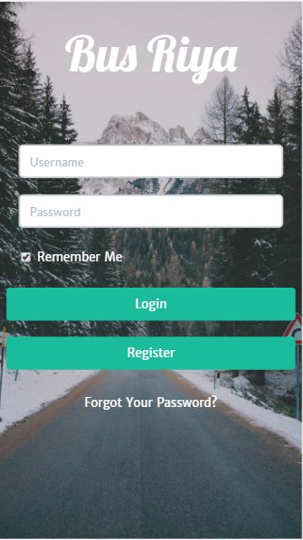
MOBILE APPLICATION
Manages Administrative Features of the System
Handles the Bus Transactions of the Server

